Slide 1
Diffusion Models
A straight to the point yet technical introduction to diffusion models

Slide 2
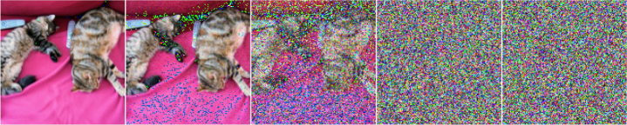
The diffusion process

Slide 3
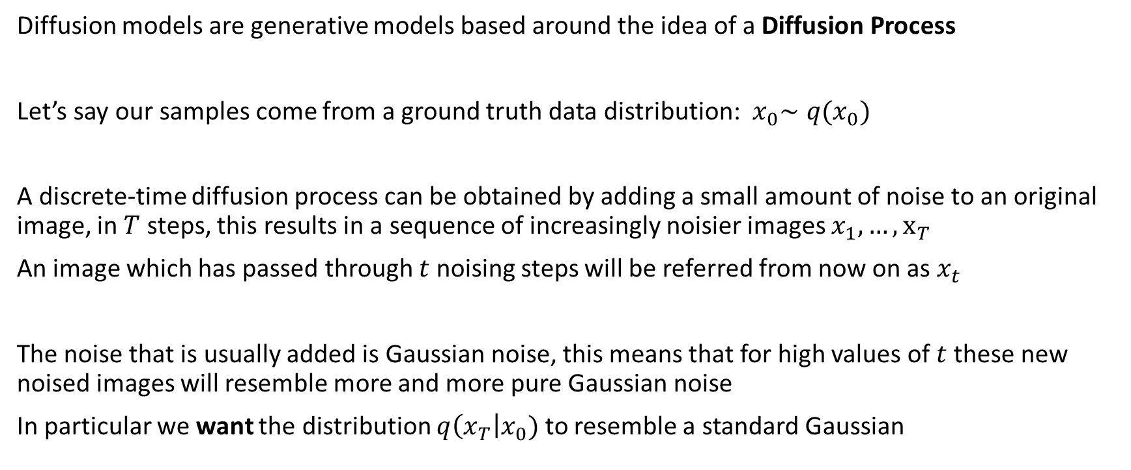
The basic diffusion process
Diffusion models are generative models based around the idea of a Diffusion Process
Let’s say our samples come from a ground truth data distribution:${ x}_{0}∼q(x_{0})$
A discrete-time diffusion process can be obtained by adding a small amount of noise to an original image, in $T$ steps, this results in a sequence of increasingly noisier images $x_{1},…, x_{T}$
An image which has passed through $t$ noising steps will be referred from now on as $x_{t}$
The noise that is usually added is Gaussian noise, this means that for high values of $t$ these new noised images will resemble more and more pure Gaussian noise
In particular we want the distribution $q\left(x_{T}\right|x_{0})$ to resemble a standard Gaussian

Slide 4
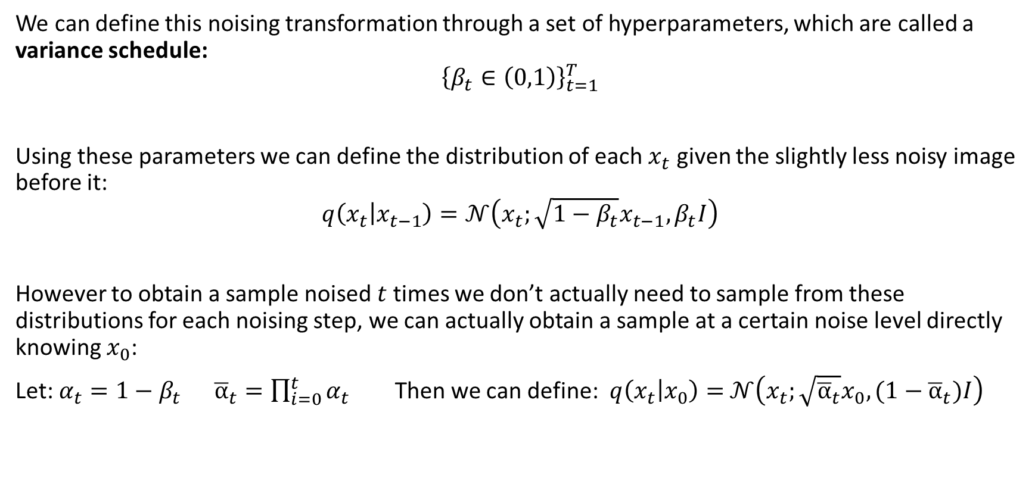
Diffusion step
We can define this noising transformation through a set of hyperparameters, which are called a variance schedule:
$${\left\{β_{t}∈\left(0,1\right)\right\}}_{t=1}^{T}$$
Using these parameters we can define the distribution of each $x_{t}$ given the slightly less noisy image before it:
$$q\left(x_{t} | x_{t−1}\right)=𝒩\left(x_{t};\sqrt{1−β_{t}}x_{t−1},β_{t}I\right)$$
However to obtain a sample noised $t$ times we don’t actually need to sample from these distributions for each noising step, we can actually obtain a sample at a certain noise level directly knowing $x_{0}$:
Let: $α_{t}=1−β_{t} {\overline{α}}_{t}=\prod_{i=0}^{t}{α_{t}}$ Then we can define: $q\left(x_{t} | x_{0}\right)=$ $𝒩\left(x_{t};\sqrt{{\overline{α}}_{t}}x_{0}, (1−{\overline{α}}_{t})I\right)$

Slide 5
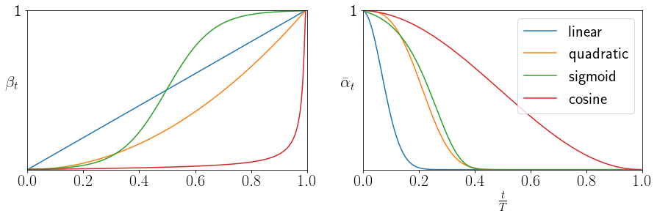
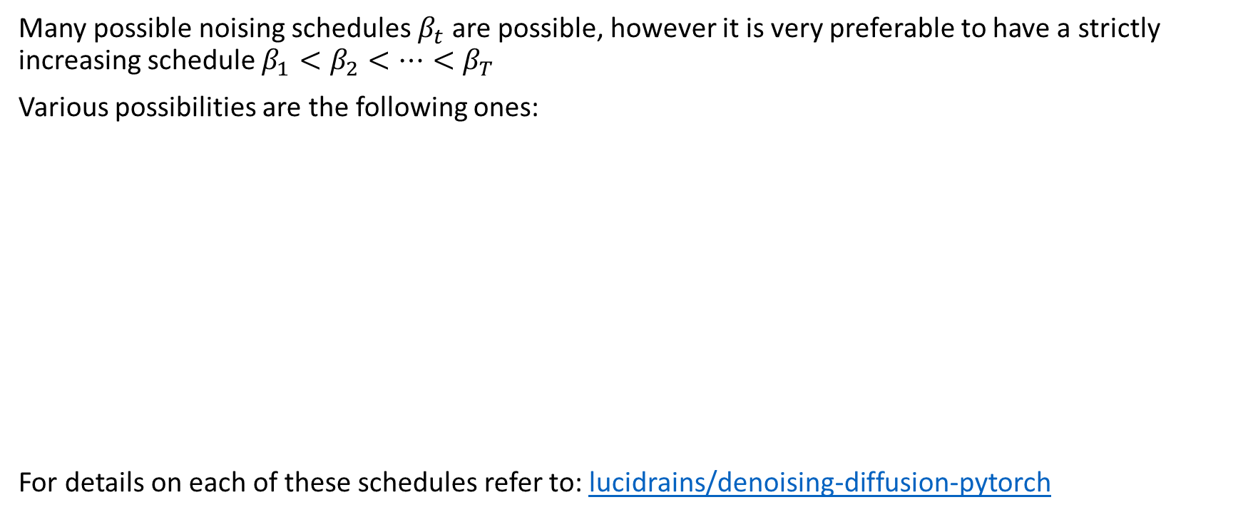
Noising schedule
Many possible noising schedules $β_{t}$ are possible, however it is very preferable to have a strictly increasing schedule $β_{1}<β_{2}<…<β_{T}$
Various possibilities are the following ones:
For details on each of these schedules refer to: lucidrains/denoising-diffusion-pytorch

Slide 6
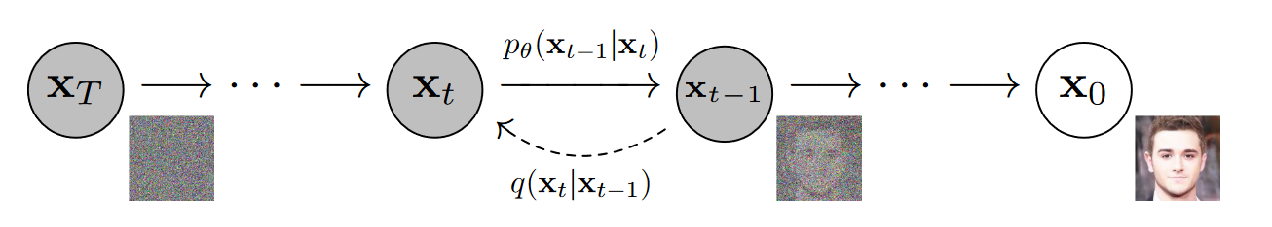
Reversing the diffusion process
Image credit: DDPM paper

Slide 7
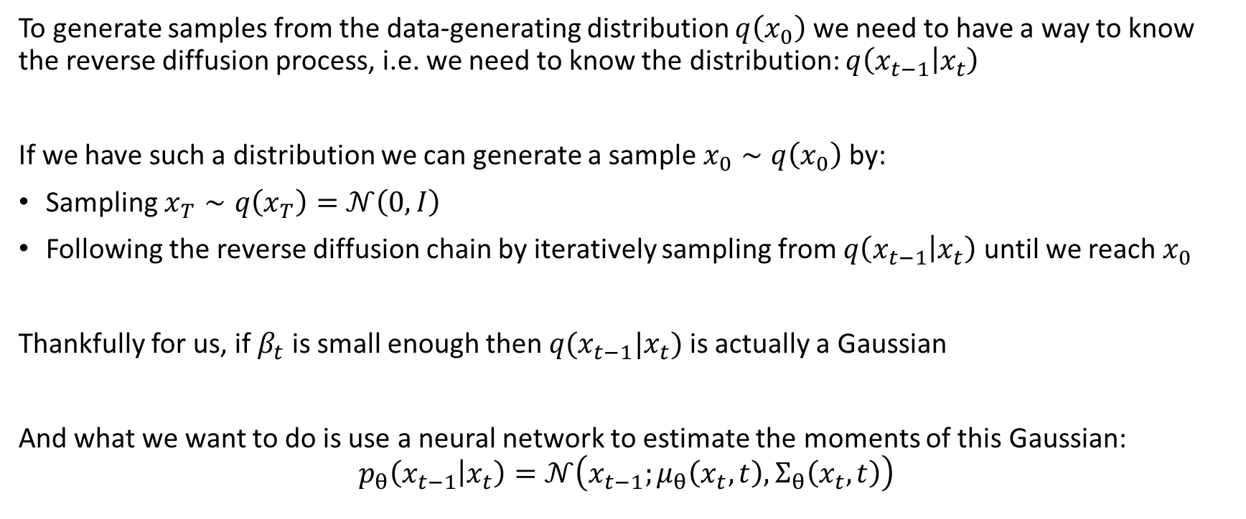
Reverse diffusion process
To generate samples from the data-generating distribution $q\left(x_{0}\right)$ we need to have a way to know the reverse diffusion process, i.e. we need to know the distribution: $q\left(x_{t−1} | x_{t}\right)$
If we have such a distribution we can generate a sample $x_{0}∼q\left(x_{0}\right)$ by:
Sampling $x_{T}∼q\left(x_{T}\right)=$ $𝒩\left(0,I\right)$
Following the reverse diffusion chain by iteratively sampling from $q\left(x_{t−1} | x_{t}\right)$ until we reach $x_{0}$
Thankfully for us, if $β_{t}$ is small enough then $q(x_{t−1}|x_{t})$ is actually a Gaussian
And what we want to do is use a neural network to estimate the moments of this Gaussian:
$$p_{θ}\left(x_{t−1} | x_{t}\right)=𝒩\left(x_{t−1};μ_{θ}\left(x_{t},t\right),Σ_{θ}\left(x_{t}, t\right)\right)$$

Slide 8
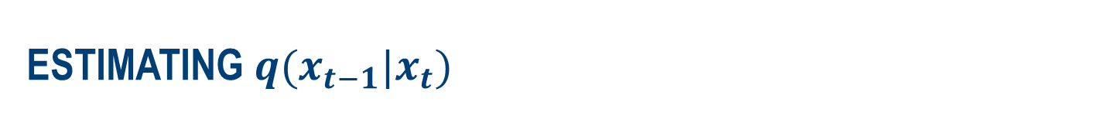
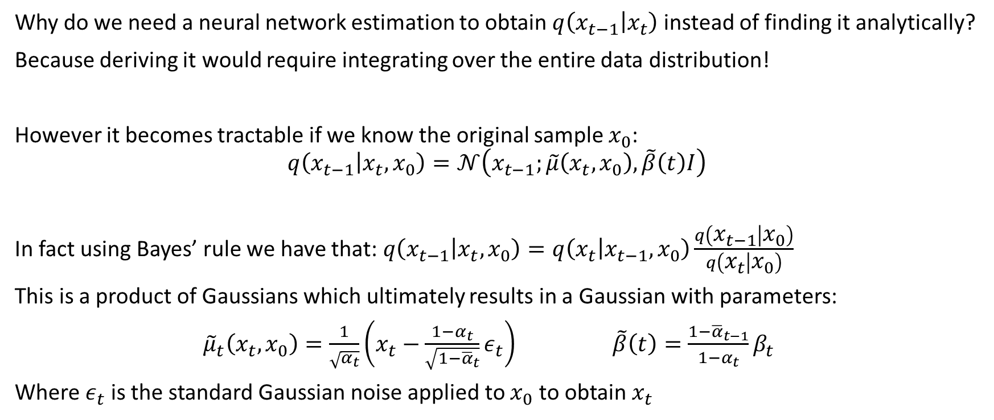
Estimating $q(x_{t−1}|x_{t})$
Why do we need a neural network estimation to obtain $q\left(x_{t−1} | x_{t}\right)$ instead of finding it analytically?
Because deriving it would require integrating over the entire data distribution!
However it becomes tractable if we know the original sample $x_{0}$:
$$q\left(x_{t−1} | x_{t}, x_{0}\right)=𝒩\left(x_{t−1};\tilde{μ}\left(x_{t},x_{0}\right),\tilde{β}\left(t\right)I\right)$$
In fact using Bayes’ rule we have that: $q\left(x_{t−1} | x_{t}, x_{0}\right)=q\left(x_{t} | x_{t−1},x_{0}\right)\frac{q\left(x_{t−1} | x_{0}\right)}{q\left(x_{t} | x_{0}\right)}$
This is a product of Gaussians which ultimately results in a Gaussian with parameters:
${\tilde{μ}}_{t}\left(x_{t},x_{0}\right)=\frac{1}{\sqrt{α_{t}}}\left(x_{t}−\frac{1−α_{t}}{\sqrt{1−{\overline{α}}_{t}}}ε_{t}\right) \tilde{β}\left(t\right)=\frac{1−{\overline{α}}_{t−1}}{1−α_{t}}β_{t}$
Where $ε_{t}$ is the standard Gaussian noise applied to $x_{0}$ to obtain $x_{t}$

Slide 9
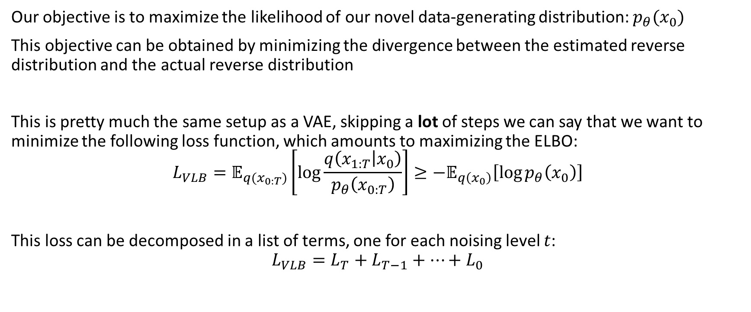
Obtaining the best generator(1)
Our objective is to maximize the likelihood of our novel data-generating distribution: $p_{θ}(x_{0})$
This objective can be obtained by minimizing the divergence between the estimated reverse distribution and the actual reverse distribution
This is pretty much the same setup as a VAE, skipping a lot of steps we can say that we want to minimize the following loss function, which amounts to maximizing the ELBO:
$$L_{VLB}=𝔼_{q(x_{0:T})}\left[\log{\frac{q\left(x_{1:T} | x_{0}\right)}{p_{θ}\left(x_{0:T}\right)}}\right]≥−𝔼_{q\left(x_{0}\right)}\left[\log{p_{θ}\left(x_{0}\right)}\right]$$
This loss can be decomposed in a list of terms, one for each noising level $t$:
$$L_{VLB}=L_{T}+L_{T−1}+…+L_{0}$$

Slide 10
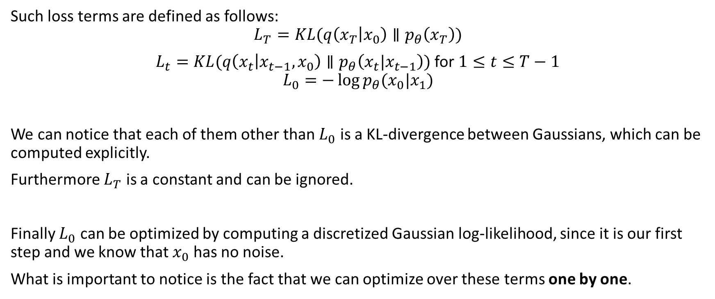
Obtaining the best generator (2)
Such loss terms are defined as follows:
$$L_{T}=KL(q\left(x_{T} | x_{0}\right)∥p_{θ}\left(x_{T}\right))$$
$L_{t}=KL(q\left(x_{t} | x_{t−1}, x_{0}\right)∥p_{θ}\left(x_{t}|x_{t−1}\right))$ for $1≤t≤T−1$
$$L_{0}=−\log{p_{θ}(x_{0}|x_{1})}$$
We can notice that each of them other than $L_{0}$ is a KL-divergence between Gaussians, which can be computed explicitly.
Furthermore $L_{T}$ is a constant and can be ignored.
Finally $L_{0}$ can be optimized by computing a discretized Gaussian log-likelihood, since it is our first step and we know that $x_{0}$ has no noise.
What is important to notice is the fact that we can optimize over these terms one by one.

Slide 11
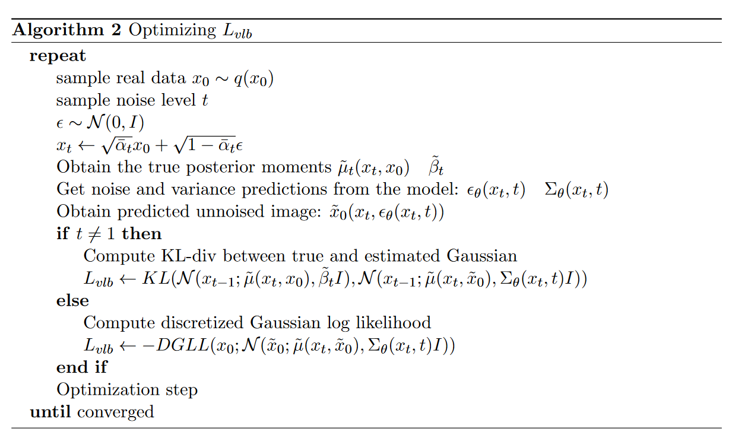
The full training procedure

Slide 12
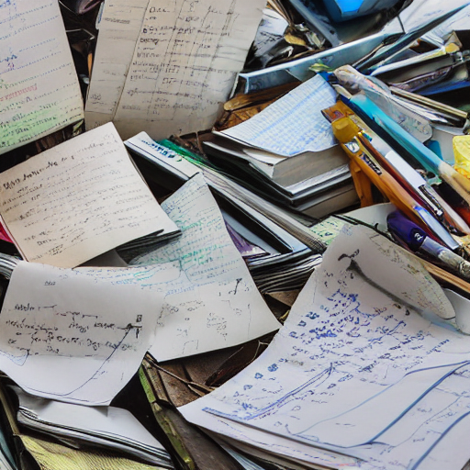
In practice

Slide 13
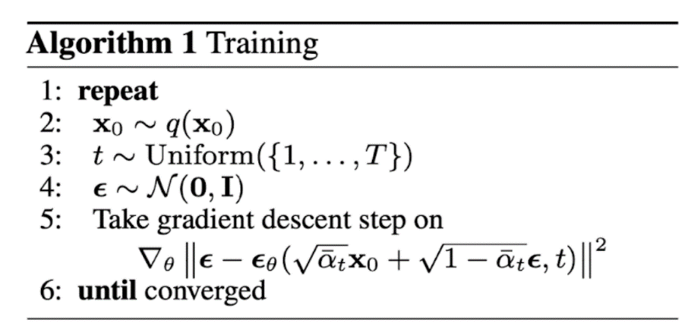
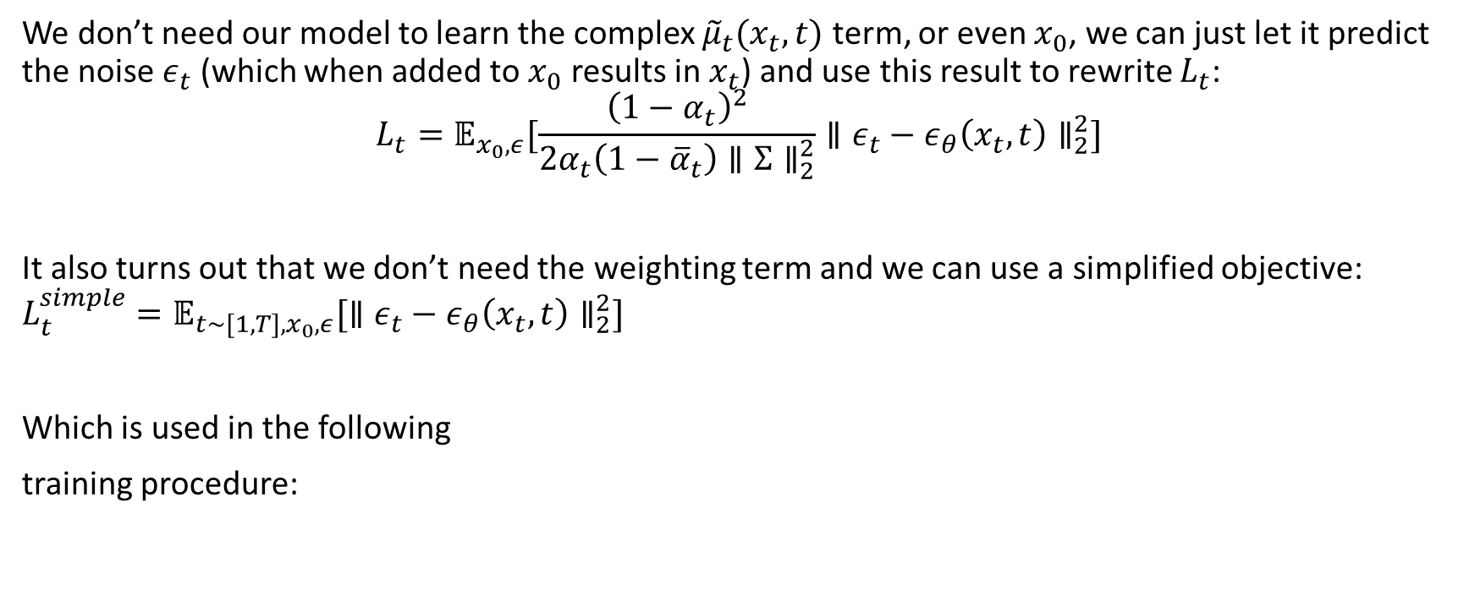
Simplified training procedure
We don’t need our model to learn the complex ${\tilde{μ}}_{t}(x_{t},t)$ term, or even $x_{0}$, we can just let it predict the noise $ε_{t}$ (which when added to $x_{0}$ results in $x_{t}$) and use this result to rewrite $L_{t}$:
$$L_{t}=𝔼_{x_{0},ε}[\frac{{\left(1−α_{t}\right)}^{2}}{2α_{t}\left(1−{\overline{α}}_{t}\right)∥Σ∥_{2}^{2}}∥ε_{t}−ε_{θ}\left(x_{t},t\right)∥_{2}^{2}]$$
It also turns out that we don’t need the weighting term and we can use a simplified objective: $L_{t}^{simple}=𝔼_{{t∼[1,T],x}_{0},ε}[∥ε_{t}−ε_{θ}\left(x_{t},t\right)∥_{2}^{2}]$
Which is used in the following
training procedure:

Slide 14
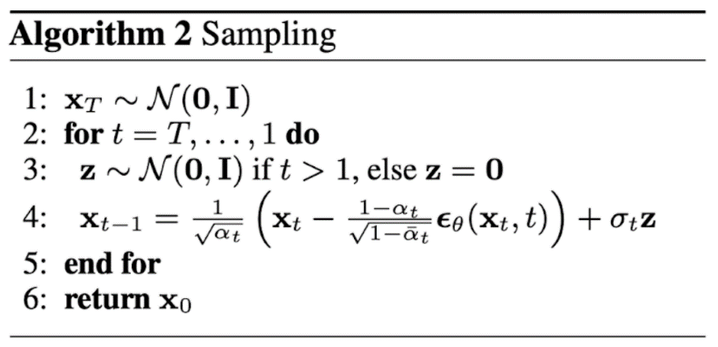
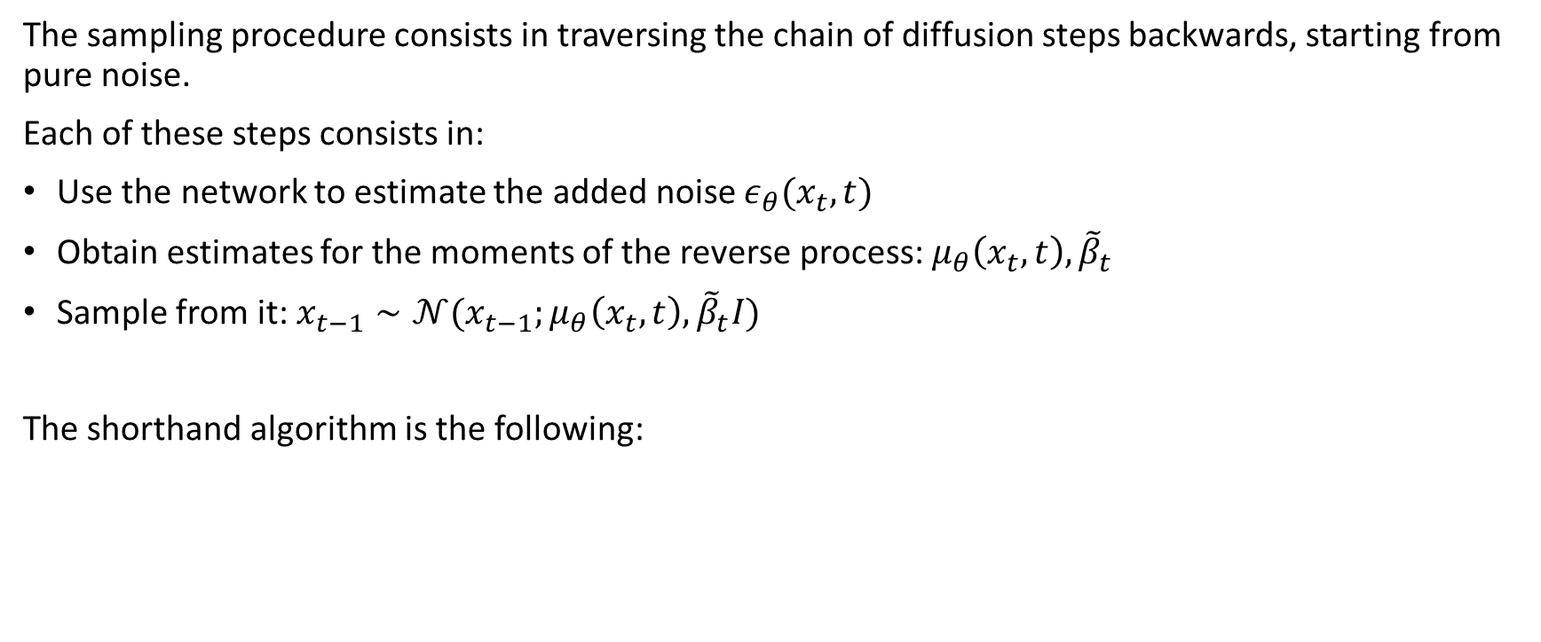
Basic sampling(DDPM)
The sampling procedure consists in traversing the chain of diffusion steps backwards, starting from pure noise.
Each of these steps consists in:
Use the network to estimate the added noise $ε_{θ}(x_{t},t)$
Obtain estimates for the moments of the reverse process: $μ_{θ}\left(x_{t},t\right), {\tilde{β}}_{t}$
Sample from it: $x_{t−1}∼𝒩(x_{t−1};μ_{θ}\left(x_{t},t\right), {\tilde{β}}_{t}I)$
The shorthand algorithm is the following:

Slide 15
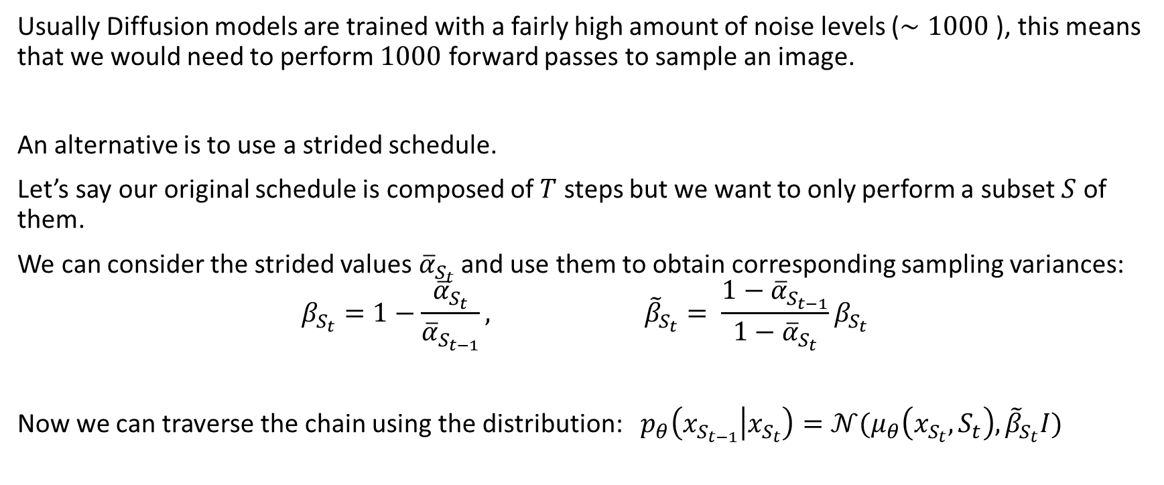
Strided Sampling
Usually Diffusion models are trained with a fairly high amount of noise levels ($∼1000$), this means that we would need to perform $1000$ forward passes to sample an image.
An alternative is to use a strided schedule.
Let’s say our original schedule is composed of $T$ steps but we want to only perform a subset $S$ of them.
We can consider the strided values ${\overline{α}}_{S_{t}}$ and use them to obtain corresponding sampling variances:
$$β_{S_{t}}=1−\frac{{\overline{α}}_{S_{t}}}{{\overline{α}}_{S_{t−1}}}, {\tilde{β}}_{S_{t}}= \frac{1−{\overline{α}}_{S_{t−1}}}{1−{\overline{α}}_{S_{t}}}β_{S_{t}}$$
Now we can traverse the chain using the distribution: $p_{θ}\left(x_{S_{t−1}} | x_{S_{t}}\right)=𝒩(μ_{θ}\left(x_{S_{t}},S_{t}\right), {\tilde{β}}_{S_{t}}I)$

Slide 16
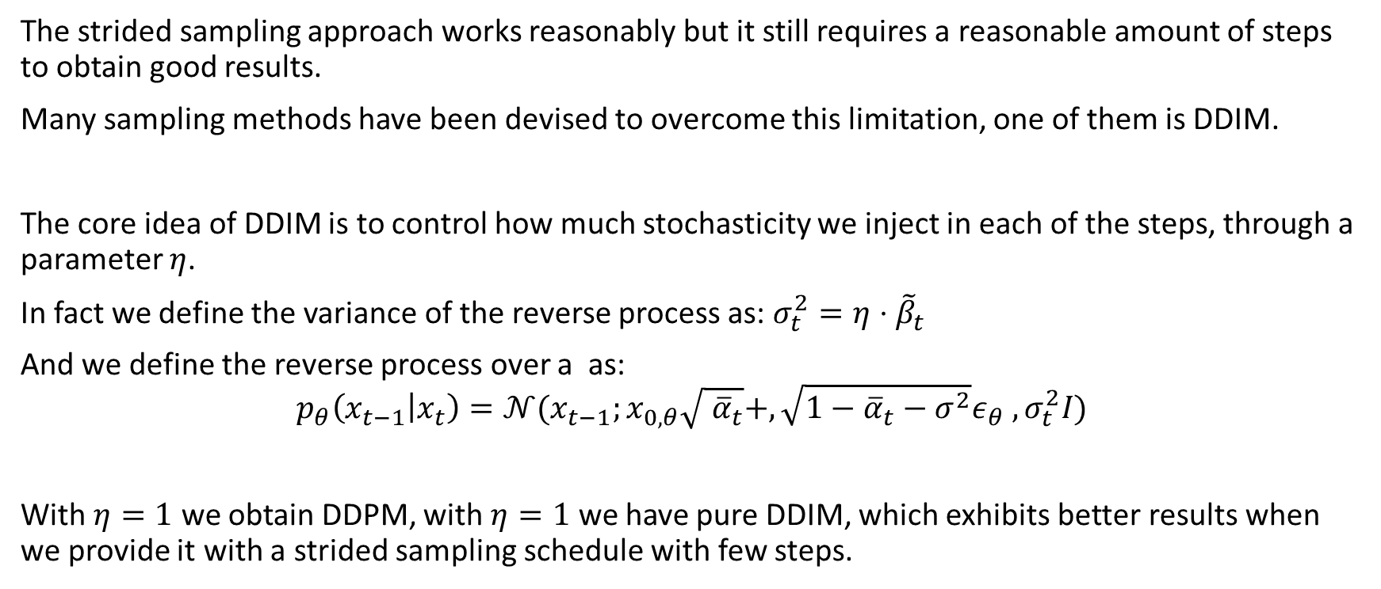
DDIM
The strided sampling approach works reasonably but it still requires a reasonable amount of steps to obtain good results.
Many sampling methods have been devised to overcome this limitation, one of them is DDIM.
The core idea of DDIM is to control how much stochasticity we inject in each of the steps, through a parameter $η$.
In fact we define the variance of the reverse process as: $σ_{t}^{2}=η⋅{\tilde{β}}_{t}$
And we define the reverse process over a as:
$$p_{θ}\left(x_{t−1} | x_{t}\right)=𝒩(x_{t−1};x_{0,θ}\sqrt{ {\overline{α}}_{t}}+,\sqrt{1−{\overline{α}}_{t}−σ^{2}}ε_{θ} , σ_{t}^{2}I)$$
With $η=1$ we obtain DDPM, with $η=1$ we have pure DDIM, which exhibits better results when we provide it with a strided sampling schedule with few steps.

Slide 17
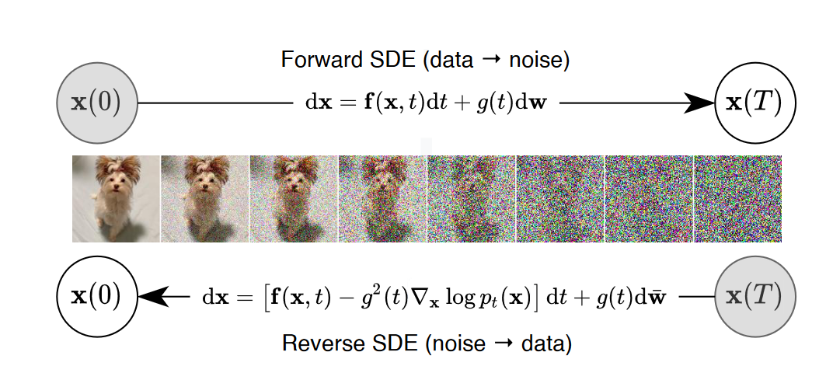
Continuous Diffusion
Image credit: Song et al. (2021)

Slide 18
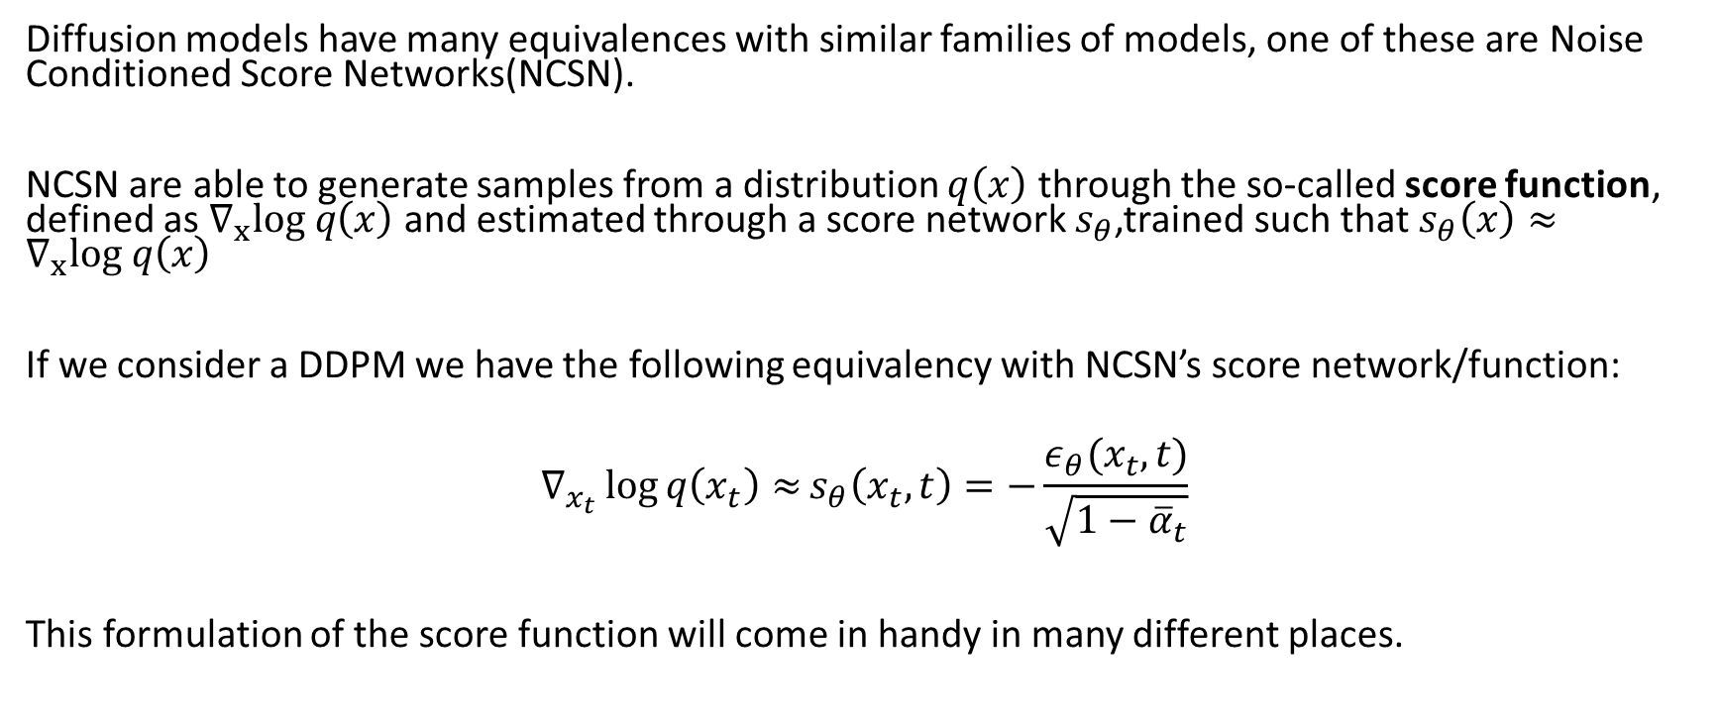
Diffusion models and NCSN
Diffusion models have many equivalences with similar families of models, one of these are Noise Conditioned Score Networks(NCSN).
NCSN are able to generate samples from a distribution $q\left(x\right)$ through the so-called score function, defined as $∇_{x}log q\left(x\right)$ and estimated through a score network $s_{θ}$,trained such that $s_{θ}\left(x\right)≈∇_{x}log q\left(x\right)$
If we consider a DDPM we have the following equivalency with NCSN’s score network/function:
$$∇_{x_{t}}\log{q\left(x_{t}\right)≈}s_{θ}\left(x_{t},t\right)=−\frac{ε_{θ}(x_{t}, t)}{\sqrt{1−{\overline{α}}_{t}}}$$
This formulation of the score function will come in handy in many different places.

Slide 19
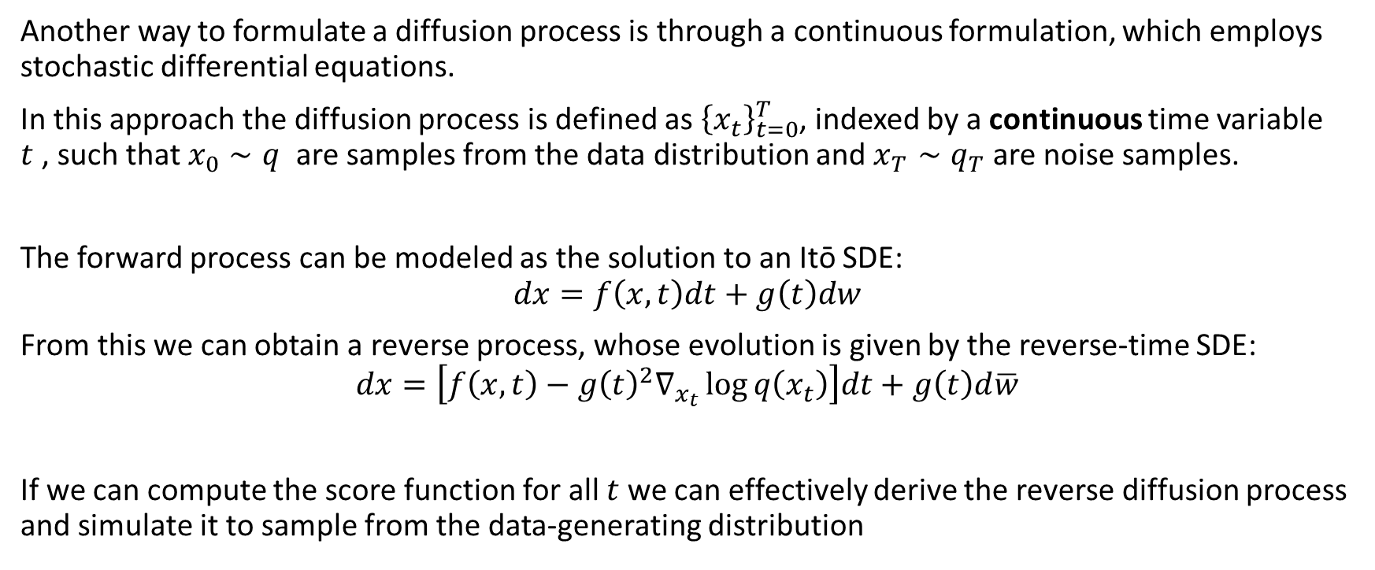
SDE formulation
Another way to formulate a diffusion process is through a continuous formulation, which employs stochastic differential equations.
In this approach the diffusion process is defined as ${\left\{x_{t}\right\}}_{t=0}^{T}$, indexed by a continuous time variable $t$, such that $x_{0}∼q$ are samples from the data distribution and $x_{T}∼q_{T}$ are noise samples.
The forward process can be modeled as the solution to an Itō SDE:
$$dx=f\left(x,t\right)dt+g\left(t\right)dw$$
From this we can obtain a reverse process, whose evolution is given by the reverse-time SDE:
$$dx=\left[f\left(x,t\right)−g{\left(t\right)}^{2}∇_{x_{t}}\log{q\left(x_{t}\right)}\right]dt+g\left(t\right)d\overline{w}$$
If we can compute the score function for all $t$ we can effectively derive the reverse diffusion process and simulate it to sample from the data-generating distribution

Slide 20
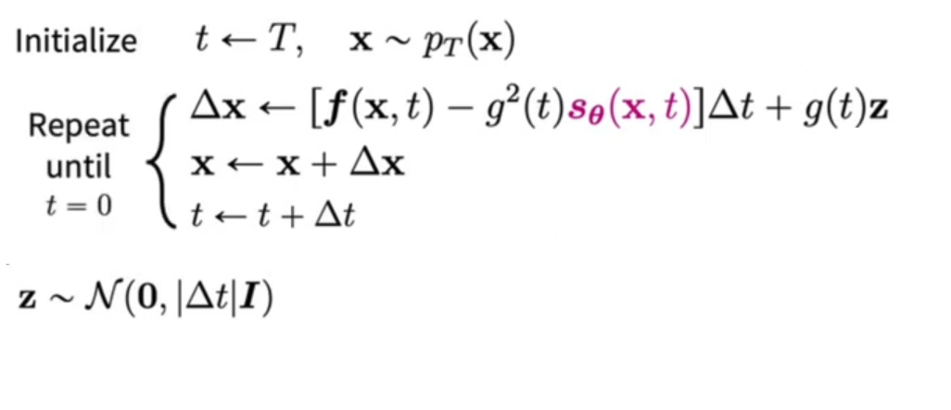
Sampling from an SDE
We can also see that DDPM is actually a discretization of a certain SDE.
The process of following the reverse diffusion chain is a discretization of the reverse-time SDE and is called ancestral sampling.
To instead use the pure SDE to generate samples we need to estimate the time-dependent score function and simulate the SDE with numerical approaches.
In particular we an either use specific or general purpose solvers, one of these is the Euler-Maruyama procedure:
source

Slide 21
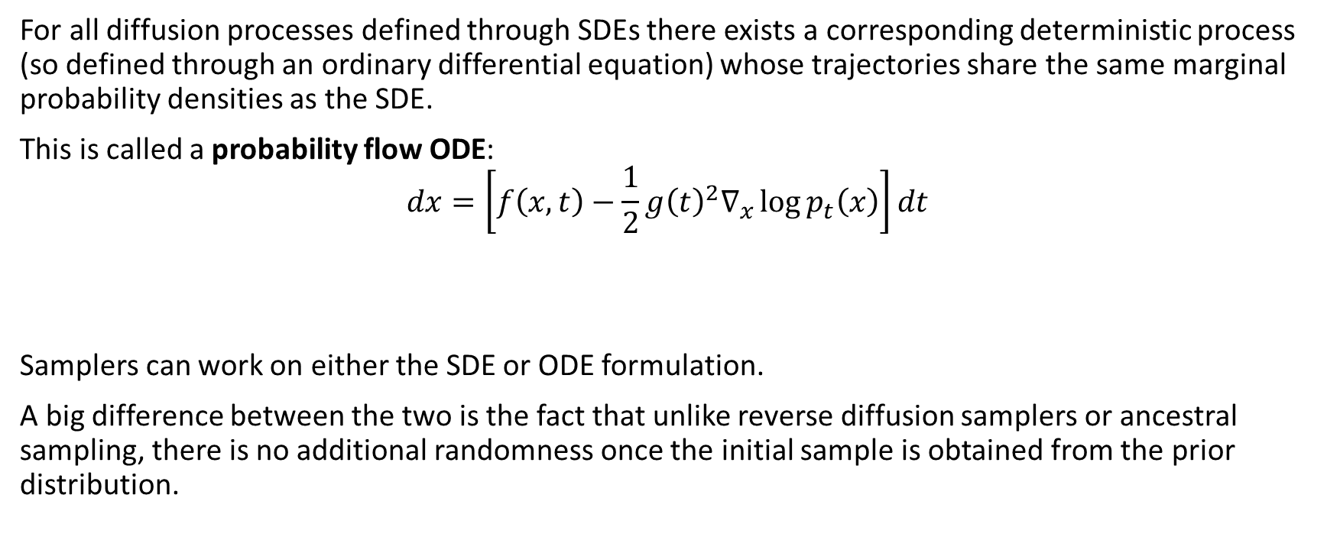
ODE Formulation
For all diffusion processes defined through SDEs there exists a corresponding deterministic process (so defined through an ordinary differential equation) whose trajectories share the same marginal probability densities as the SDE.
This is called a probability flow ODE:
$$dx=\left[f\left(x,t\right)−\frac{1}{2}g{\left(t\right)}^{2}∇_{x}\log{p_{t}\left(x\right)}\right]dt$$
Samplers can work on either the SDE or ODE formulation.
A big difference between the two is the fact that unlike reverse diffusion samplers or ancestral sampling, there is no additional randomness once the initial sample is obtained from the prior distribution.

Slide 22
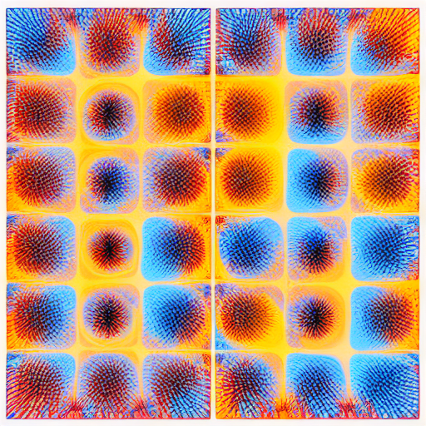
Elucidating diffusion

Slide 23
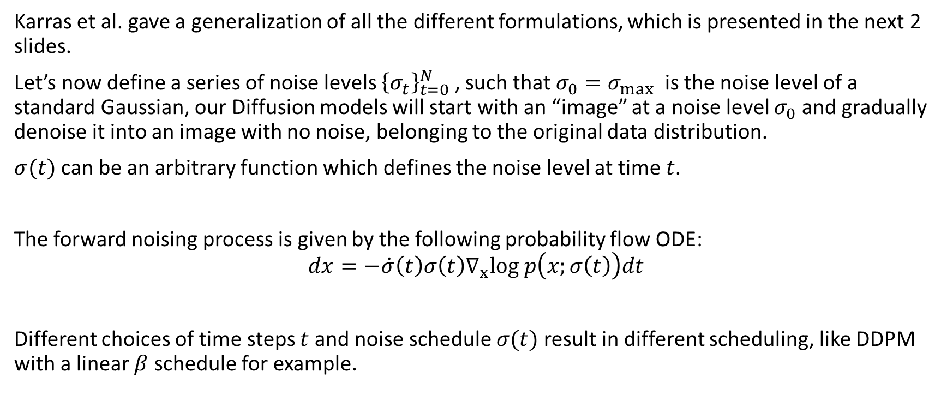
Elucidating diffusion formulation
Karras et al. gave a generalization of all the different formulations, which is presented in the next 2 slides.
Let’s now define a series of noise levels ${\left\{σ_{t}\right\}}_{t=0}^{N}$ , such that $σ_{0}=σ_{max}$ is the noise level of a standard Gaussian, our Diffusion models will start with an “image” at a noise level $σ_{0}$ and gradually denoise it into an image with no noise, belonging to the original data distribution.
$σ(t)$ can be an arbitrary function which defines the noise level at time $t$.
The forward noising process is given by the following probability flow ODE:
$$dx=−\dot{σ}\left(t\right)σ\left(t\right)∇_{x}log p\left(x;σ\left(t\right)\right)dt$$
Different choices of time steps $t$ and noise schedule $σ(t)$ result in different scheduling, like DDPM with a linear $β$ schedule for example.

Slide 24
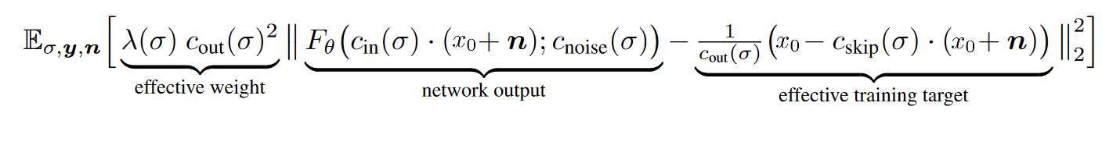
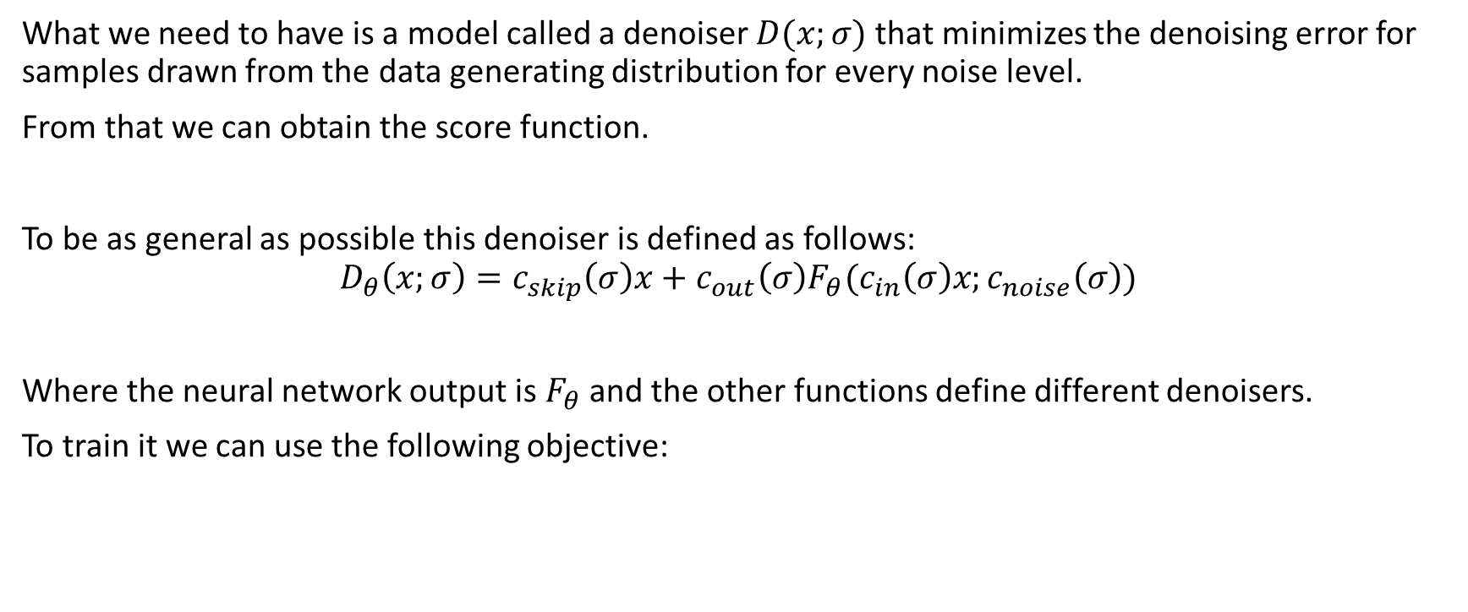
Denoiser
What we need to have is a model called a denoiser $D(x;σ)$ that minimizes the denoising error for samples drawn from the data generating distribution for every noise level.
From that we can obtain the score function.
To be as general as possible this denoiser is defined as follows:
$$D_{θ}\left(x;σ\right)=c_{skip}\left(σ\right)x+c_{out}\left(σ\right)F_{θ}(c_{in}\left(σ\right)x;c_{noise}\left(σ\right))$$
Where the neural network output is $F_{θ}$ and the other functions define different denoisers.
To train it we can use the following objective:

Slide 25
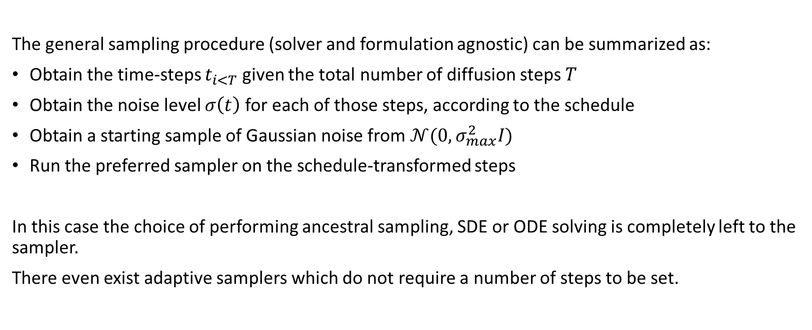
Sampling
The general sampling procedure (solver and formulation agnostic) can be summarized as:
Obtain the time-steps $t_{i<T}$ given the total number of diffusion steps $T$
Obtain the noise level $σ\left(t\right)$for each of those steps, according to the schedule
Obtain a starting sample of Gaussian noise from $𝒩(0,σ_{max}^{2}I)$
Run the preferred sampler on the schedule-transformed steps
In this case the choice of performing ancestral sampling, SDE or ODE solving is completely left to the sampler.
There even exist adaptive samplers which do not require a number of steps to be set.

Slide 26
Samplers
There are many possible samplers that we can use, some of them have a correlated paper, most of them are impenetrable horrors whose inner workings are only privy to those who made them.
Euler
Euler a
LMS
DPM2
DPM2 a
DPM++ 2S a
Despite all of this it turns out that sampler choice does not matter much if we use more than 20 steps. The biggest difference considering results seems to be between ancestral (a), non-ancestral and SDE-based samplers.
DPM++ SM
DPM++ SDE
DPM fast
DPM adaptive
LMS Karras
DPM2 Karras
DPM2 a Karras
DPM++ 2S a Karras
DPM++ 2M Karras
DPM++ SDE
DDIM
PLMS
UniPC

Slide 27
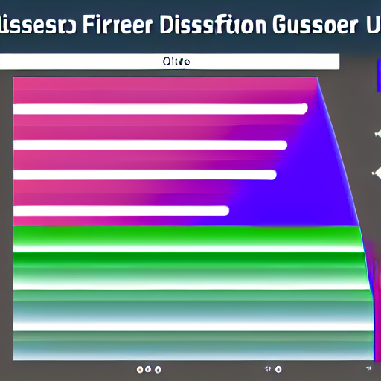
Guiding diffusion

Slide 28
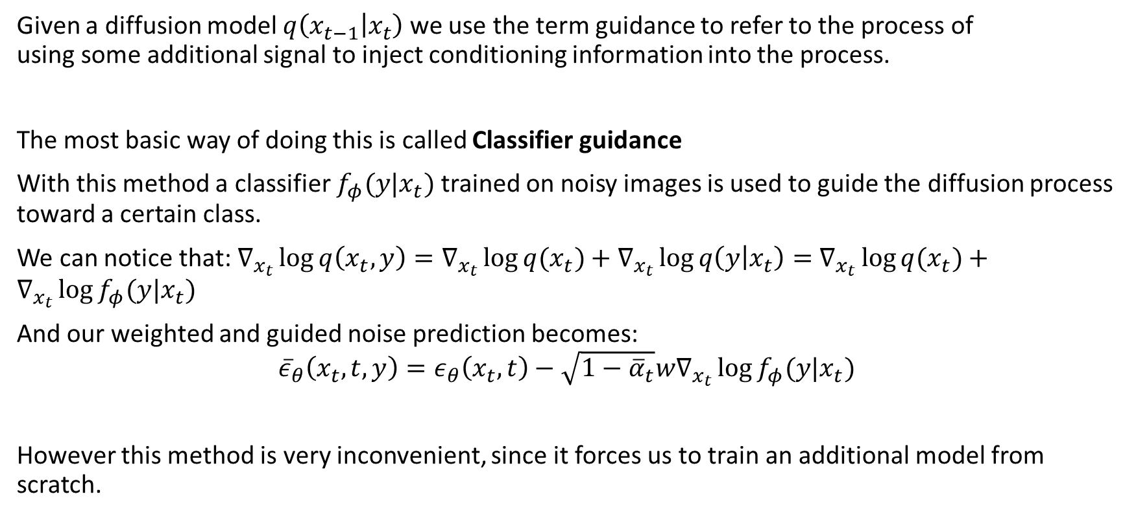
Classifier guidance
Given a diffusion model $q\left(x_{t−1} | x_{t}\right)$ we use the term guidance to refer to the process of using some additional signal to inject conditioning information into the process.
The most basic way of doing this is called Classifier guidance
With this method a classifier $f_{φ}(y|x_{t})$ trained on noisy images is used to guide the diffusion process toward a certain class.
We can notice that: $∇_{x_{t}}\log{q\left(x_{t},y\right)=∇_{x_{t}}\log{q(x_{t})}+∇_{x_{t}}\log{q\left(y | x_{t}\right)=}}$ $∇_{x_{t}}\log{q(x_{t})}+∇_{x_{t}}\log{f_{φ}(y|x_{t})}$
And our weighted and guided noise prediction becomes:
$${\overline{ε}}_{θ}\left(x_{t},t,y\right)=ε_{θ}\left(x_{t},t\right)−\sqrt{1−{\overline{α}}_{t}}w∇_{x_{t}}\log{f_{φ}(y|x_{t})}$$
However this method is very inconvenient, since it forces us to train an additional model from scratch.

Slide 29
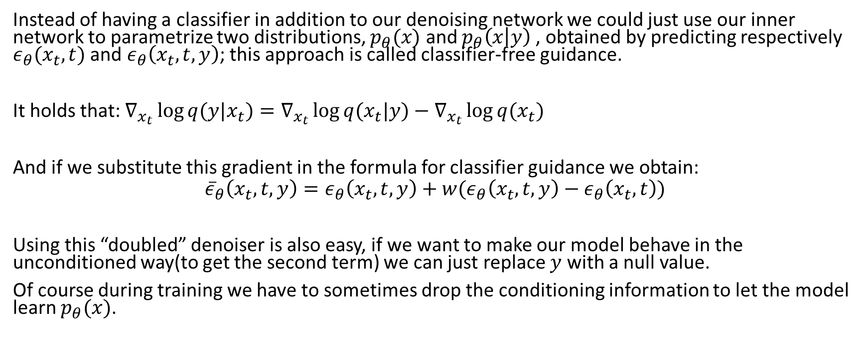
Classifier-Free guidance
Instead of having a classifier in addition to our denoising network we could just use our inner network to parametrize two distributions, $p_{θ}(x)$ and $p_{θ}\left(x | y\right)$, obtained by predicting respectively $ε_{θ}(x_{t}, t)$ and $ε_{θ}\left(x_{t},t,y\right)$; this approach is called classifier-free guidance.
It holds that: $∇_{x_{t}}\log{q(y|x_{t})}=∇_{x_{t}}\log{q(x_{t}|y)}−∇_{x_{t}}\log{q(x_{t})}$
And if we substitute this gradient in the formula for classifier guidance we obtain:
$${\overline{ε}}_{θ}\left(x_{t},t,y\right)=ε_{θ}\left(x_{t},t,y\right)+w(ε_{θ}\left(x_{t},t,y\right)−ε_{θ}\left(x_{t},t\right))$$
Using this “doubled” denoiser is also easy, if we want to make our model behave in the unconditioned way(to get the second term) we can just replace $y$ with a null value.
Of course during training we have to sometimes drop the conditioning information to let the model learn $p_{θ}(x)$.

Slide 30
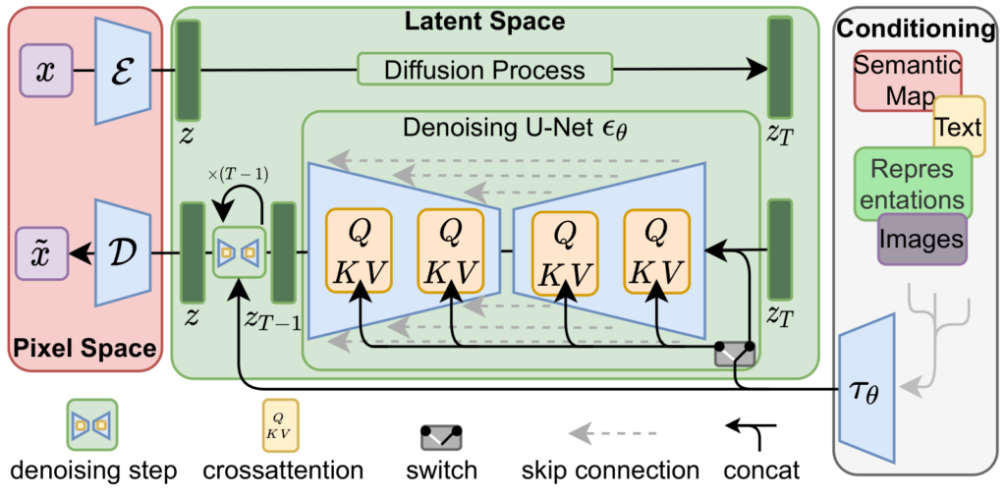
Latent diffusion
Image credit: Rombach et al. (2022)

Slide 31
Running diffusion in the latent space
Both inference and training of diffusion models is quite expensive, and the computational cost scales quadratically with the resolution of input images.
Can we do better?
The main idea of the Latent Diffusion approach is to run the diffusion process in the latent space of an autoencoder, this makes our denoiser work on lower-dimensional data than before.
We now have to train two (partially independent) models, with the denoiser only taking latents as inputs and only providing latents as outputs.
If we want to re-obtain real images we just need to pass the denoised latents to the decoder.
Another advantage of this approach is the newly gained ability of manipulating the latent space.

Slide 32
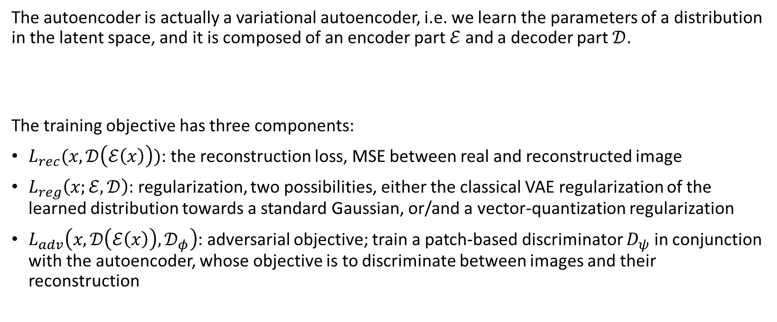
The Autoencoder
The autoencoder is actually a variational autoencoder, i.e. we learn the parameters of a distribution in the latent space, and it is composed of an encoder part $ℰ$ and a decoder part $𝒟$.
The training objective has three components:
$L_{rec}(x, 𝒟\left(ℰ\left(x\right)\right))$: the reconstruction loss, MSE between real and reconstructed image
$L_{reg}\left(x;ℰ,𝒟\right)$: regularization, two possibilities, either the classical VAE regularization of the learned distribution towards a standard Gaussian, or/and a vector-quantization regularization
$L_{adv}\left(x,𝒟\left(ℰ\left(x\right)\right),𝒟_{φ}\right)$: adversarial objective; train a patch-based discriminator $D_{ψ}$ in conjunction with the autoencoder, whose objective is to discriminate between images and their reconstruction

Slide 33
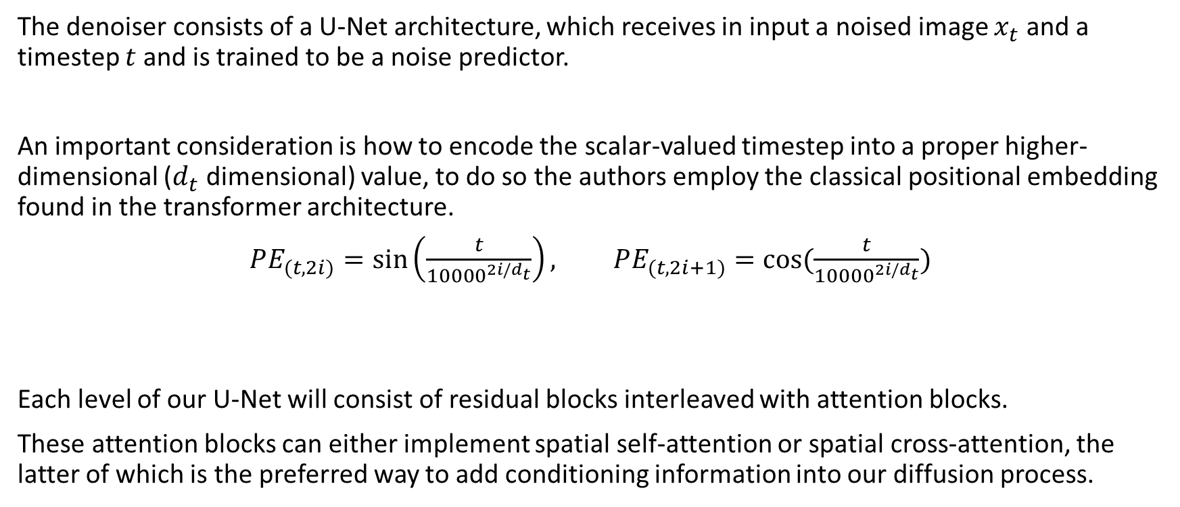
The denoiser
The denoiser consists of a U-Net architecture, which receives in input a noised image $x_{t}$ and a timestep $t$ and is trained to be a noise predictor.
An important consideration is how to encode the scalar-valued timestep into a proper higher-dimensional ($d_{t}$ dimensional) value, to do so the authors employ the classical positional embedding found in the transformer architecture.
$PE_{(t,2i)}=\sin\left(\frac{t}{{10000}^{2i/d_{t}}}\right), PE_{(t,2i+1)}=\cos{(\frac{t}{{10000}^{2i/d_{t}}})}$
Each level of our U-Net will consist of residual blocks interleaved with attention blocks.
These attention blocks can either implement spatial self-attention or spatial cross-attention, the latter of which is the preferred way to add conditioning information into our diffusion process.

Slide 34
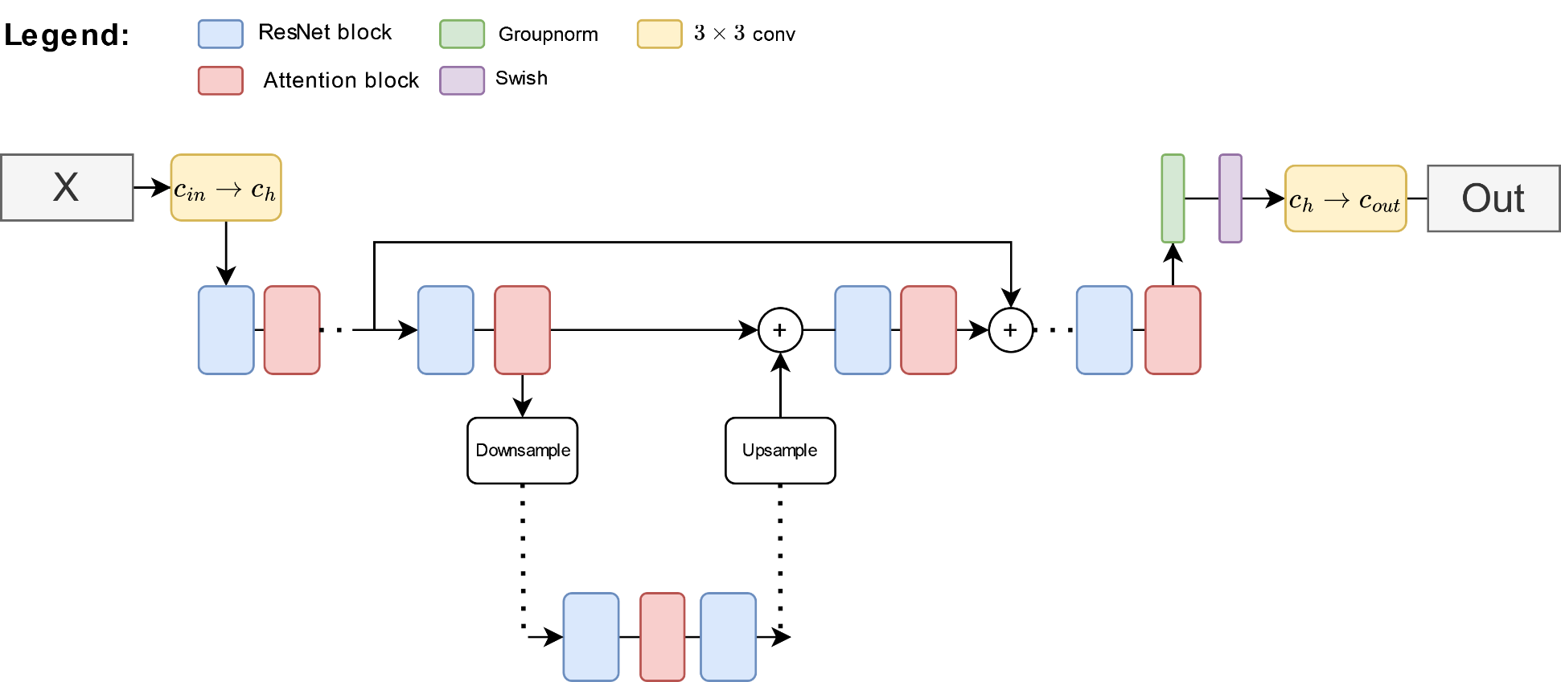
u-Net architecture

Slide 35
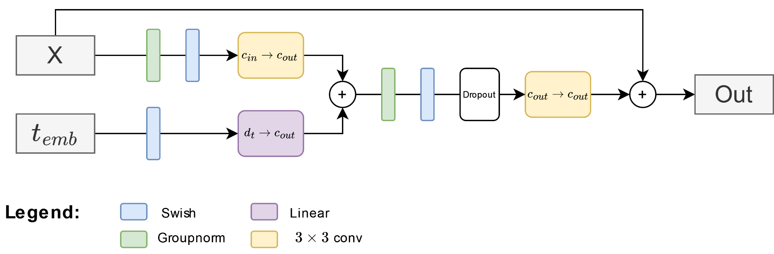
Residual block

Slide 36
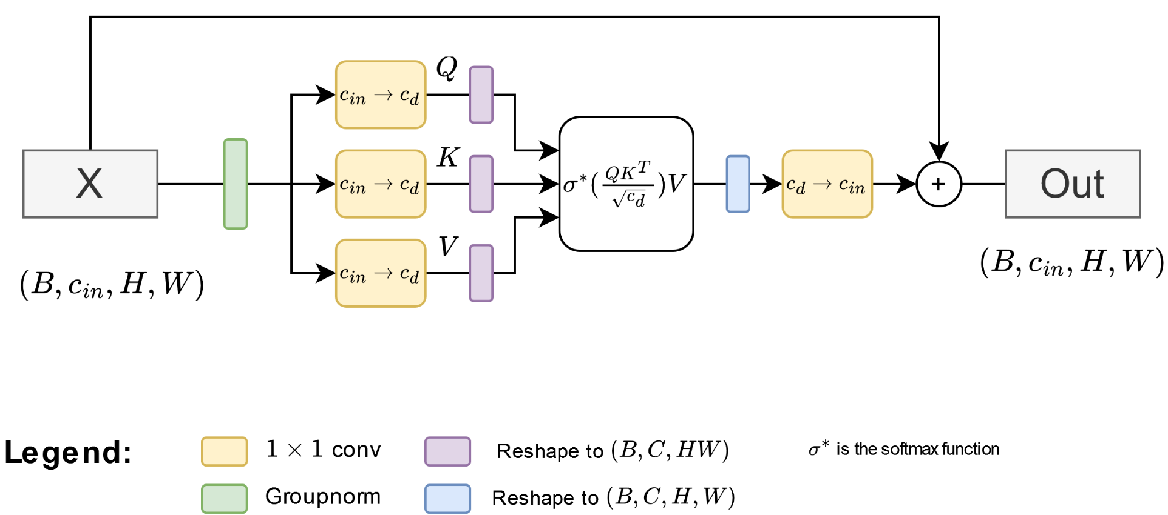
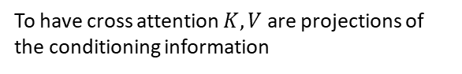
Spatial Attention
To have cross attention $K,V$ are projections of the conditioning information

Slide 37
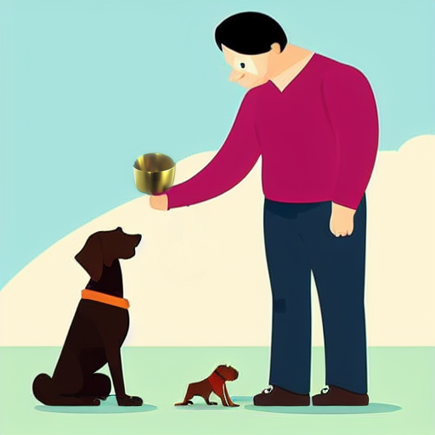
Conditioning and Tricks

Slide 38
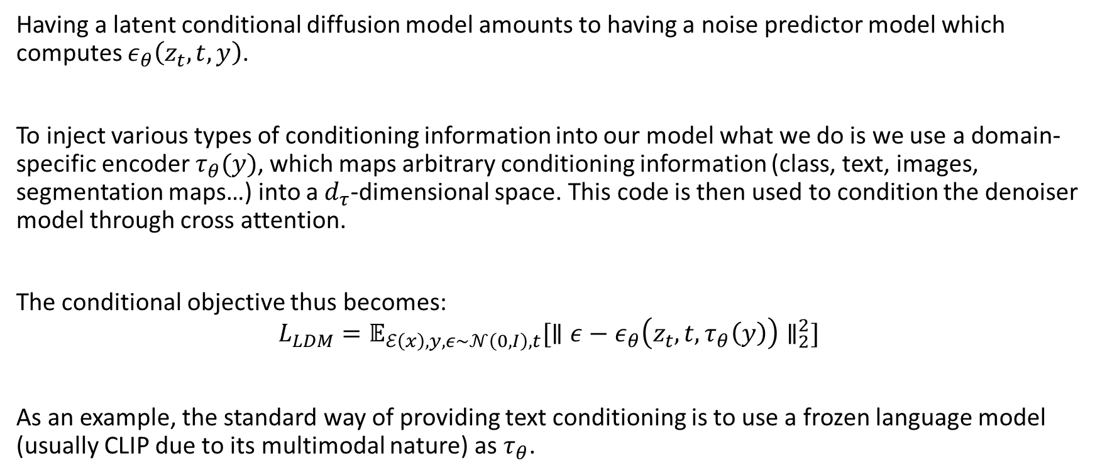
General conditioning
Having a latent conditional diffusion model amounts to having a noise predictor model which computes $ε_{θ}\left(z_{t},t,y\right)$.
To inject various types of conditioning information into our model what we do is we use a domain-specific encoder $τ_{θ}(y)$, which maps arbitrary conditioning information (class, text, images, segmentation maps…) into a $d_{τ}$-dimensional space. This code is then used to condition the denoiser model through cross attention.
The conditional objective thus becomes:
$$L_{LDM}=𝔼_{ℰ\left(x\right),y,ε∼𝒩\left(0,I\right),t}[∥ε−ε_{θ}\left(z_{t},t, τ_{θ}\left(y\right)\right)∥_{2}^{2}]$$
As an example, the standard way of providing text conditioning is to use a frozen language model (usually CLIP due to its multimodal nature) as $τ_{θ}$.

Slide 39
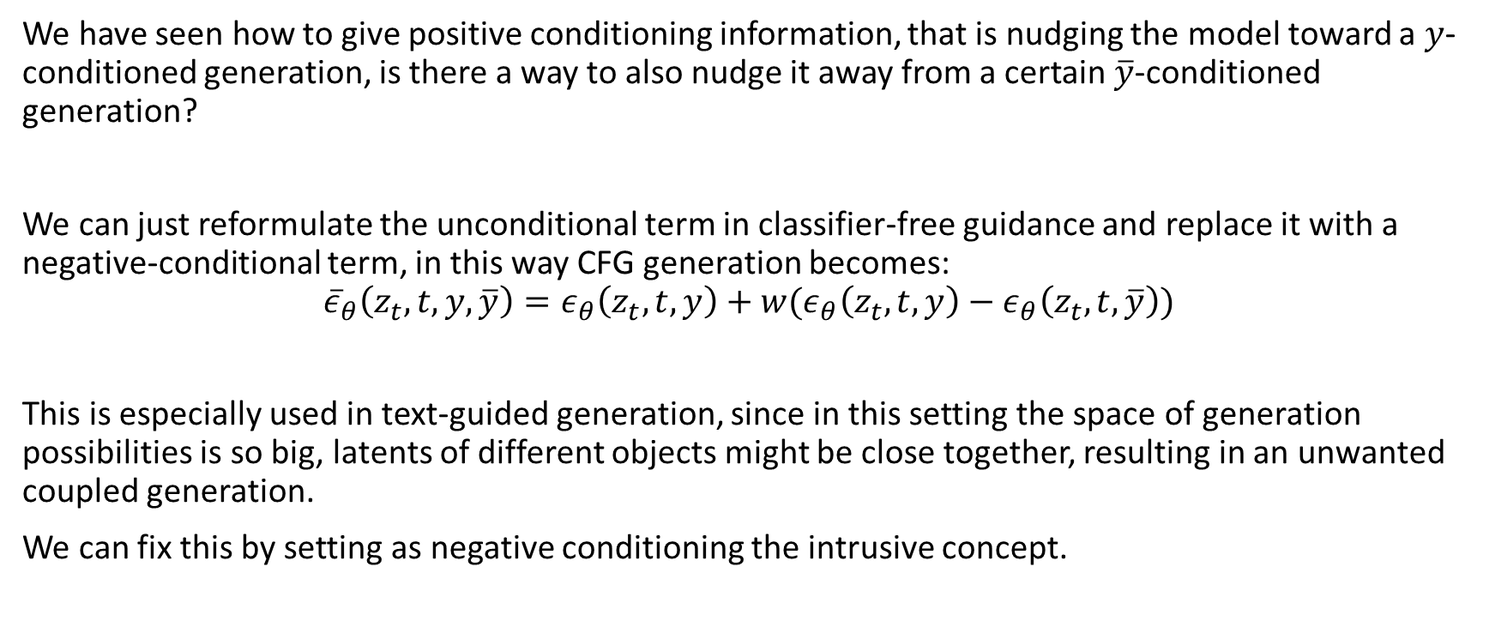
Negative prompting
We have seen how to give positive conditioning information, that is nudging the model toward a $y$-conditioned generation, is there a way to also nudge it away from a certain $\overline{y}$-conditioned generation?
We can just reformulate the unconditional term in classifier-free guidance and replace it with a negative-conditional term, in this way CFG generation becomes:
$${\overline{ε}}_{θ}\left(z_{t},t,y,\overline{y}\right)=ε_{θ}\left(z_{t},t,y\right)+w(ε_{θ}\left(z_{t},t,y\right)−ε_{θ}\left(z_{t},t,\overline{y}\right))$$
This is especially used in text-guided generation, since in this setting the space of generation possibilities is so big, latents of different objects might be close together, resulting in an unwanted coupled generation.
We can fix this by setting as negative conditioning the intrusive concept.

Slide 40
Img2IMG
Image conditioning can be done through the cross-attention mechanism as we have seen, however if we want to really mimic the image the conditioning signal might not be strong enough.
In this case we can use a different type of conditioning, namely conditioning by starting with a pre-existing latent.
Given an image that we want to transform we can proceed as follows:
Encode the input image with the encoder to get the estimated moments
Sample from a Gaussian parametrized in that way
Run the sampled latent under the diffusion process, adding other conditioning information through cross-attention
The more steps of the diffusion process we run the more different our output latent will be to the original, we can control this duration through a parameter referred to as denoising strength.

Slide 41
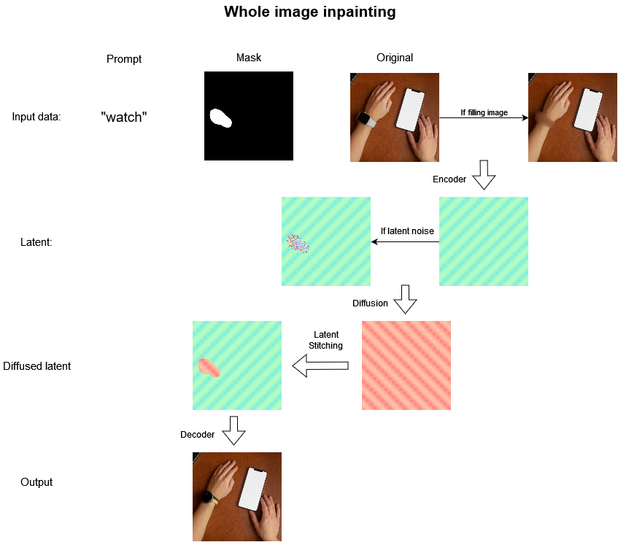
Inpainting
Inpainting refers to the procedure of taking an input image, defining a mask and the modifying only the content of that mask

Slide 42
Resources

Slide 43
Main Papers
What are diffusion models?
Denoising Diffusion Probabilistic Models
Improved Denoising Diffusion Probabilistic Models
Generative Modeling by Estimating Gradients of the Data Distribution
Score-Based Generative Modeling Through Stochastic Differential Equations
Elucidating the Design Space of Diffusion-Based Generative ModelsLatent diff
Classifier-Free Diffusion Guidance
Denoising Diffusion Implicit Models

Slide 44
Repositories and libraries
https://github.com/hojonathanho/diffusion
https://github.com/lucidrains/denoising-diffusion-pytorch
https://github.com/mikonvergence/DiffusionFastForward
https://github.com/crowsonkb/k-diffusion
https://github.com/CompVis/latent-diffusion
https://github.com/CompVis/stable-diffusion
https://github.com/AUTOMATIC1111/stable-diffusion-webui
https://huggingface.co/docs/diffusers/index

